Slide 1
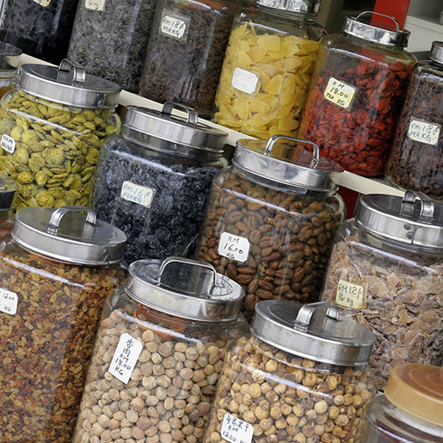
Network Pharmacology-Based Analysis of the Role of Traditional Chinese Herbal Medicines in the Treatment of Migraine
Paul Kalnins, ND, MS
NLM/OHSU Postdoctoral Fellow (Bioinformatics & Computational Biomedicine)
kalninsp@ohsu.edu
BMI 567 | Final Project | March 18, 2024

Slide 2
Classical Pharmacodynamics
Agent
Drug, compound
Target
Protein (gene)
Receptor, enzyme, etc.
Biological Pathway
Cellular function
A ‘single-drug’, ‘single-target’ paradigm has dominated drug discovery for decades
Some have argued this paradigm has limited the drug discovery space

Slide 3
Migraine Headache
A recurring, disabling neurological condition (affects 10-20% of population)
Pathophysiology: Several distinct stages with complex symptomology
Hypothalamic activation
Cortical spreading depression (CSD)
Trigeminal-vascular activation (peripheral & central)
Neuropeptide imbalances: 5-HT, DA, GABA-A, CGRP, substance P, Glu, etc.
Biomedical treatment: abortive & prophylactic
Outcomes: mixed results (triptans give ~68% pain-free response in 2 hours, ~54% in 24 hours
Migraine Therapies
Abortive
NSAIDs
Triptans
DA agonists
Prophylaxis
Beta blockers
TCAs
Topiramate
MAOIs
CGRP inhibitors
Botox
Gabapentin
Sumatriptan
Imitrex®
5-HT_{1D,} 5-HT_{1B}
Serotonin receptor agonist
Mechanism of Action
Blocks CGRP release
Inhibits vasodilation
Decreases trigeminal activity
Thorlund K, Mills EJ, Wu P, et al. Comparative efficacy of triptans for the abortive treatment of migraine: a multiple treatment comparison meta-analysis. Cephalalgia. 2014;34(4):258-267

Slide 4
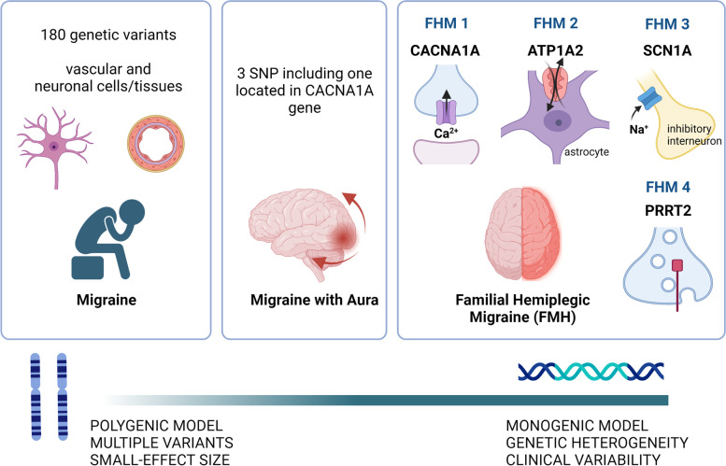
Migraine Headache & Genes
Migraine is a complex genetic/polygenetic disorder
GWAS have identified over 180 genetic variants in common migraine
Most involve complex networks of neuronal or vascular molecular abnormalities
Shared genetic factors between migraine and co-morbidities (depression, high blood pressure, etc.)
GeneCards (www.genecards.org)
1500 total genes (accessed 3/12/24)
Disgenet (www.disgenet.org)
512 total genes (accessed 3/12/24)
Grangeon L, Lange KS, Waliszewska-Prosół M, Onan D, Marschollek K, Wiels W, Mikulenka P, Farham F, Gollion C, Ducros A; European Headache Federation School of Advanced Studies (EHF-SAS). Genetics of migraine: where are we now? J Headache Pain. 2023 Feb 20;24(1):12.

Slide 5
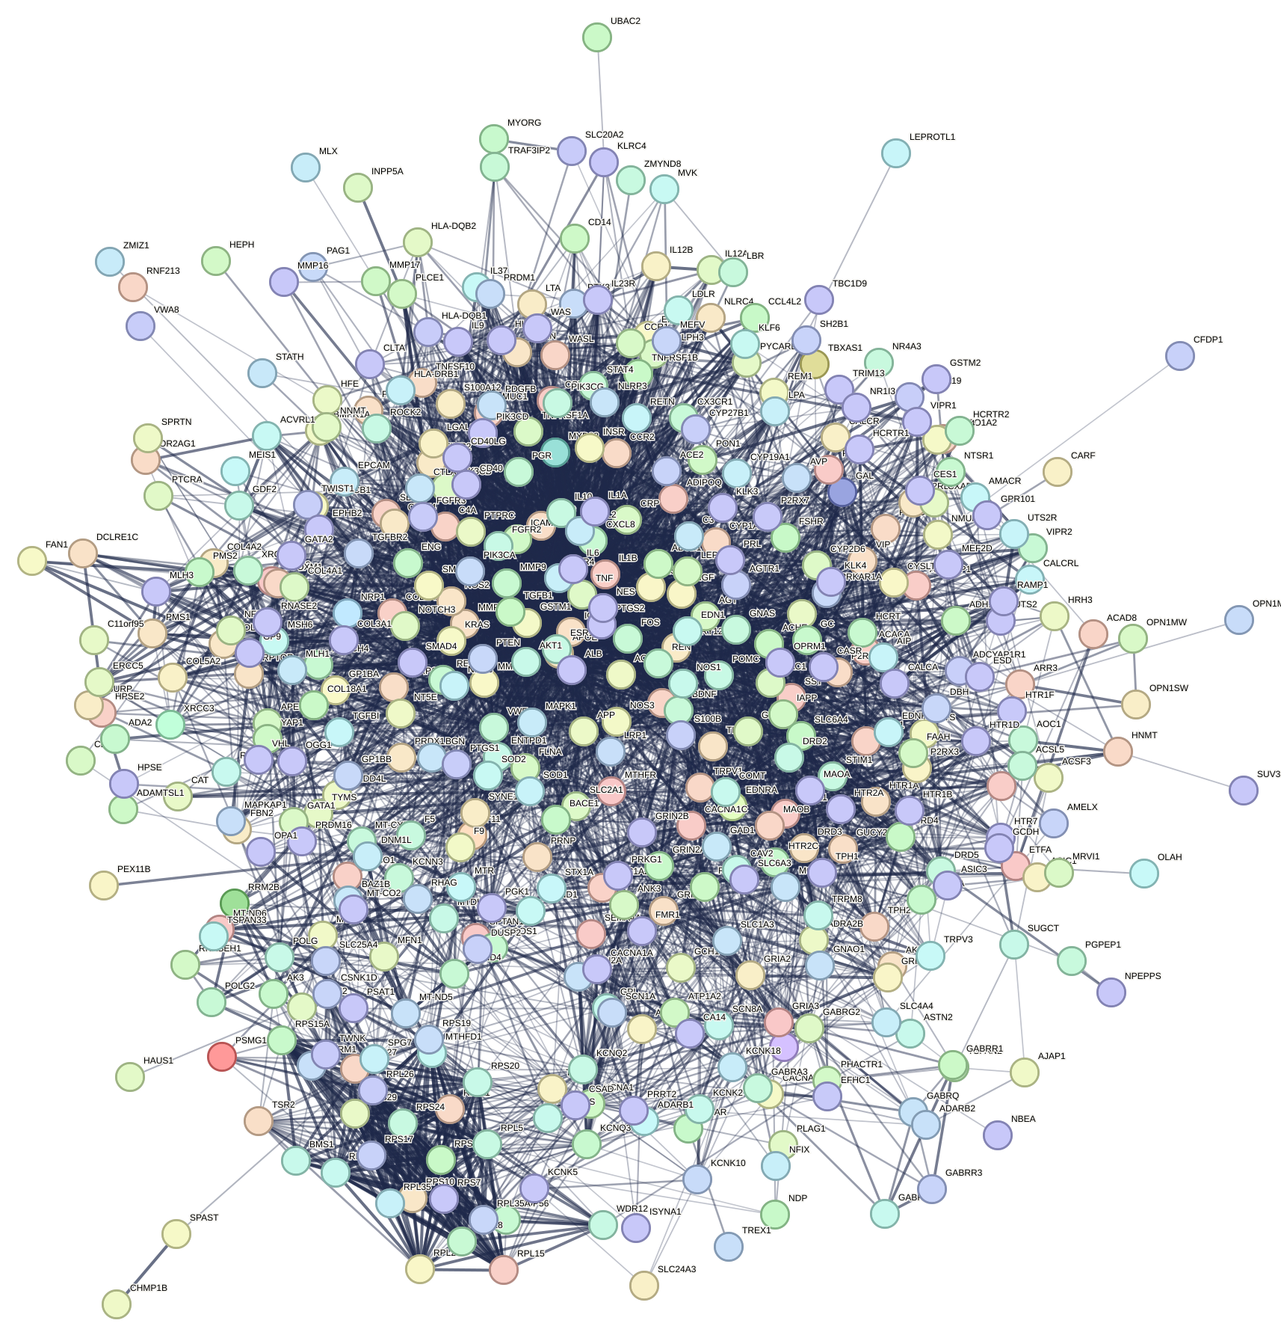
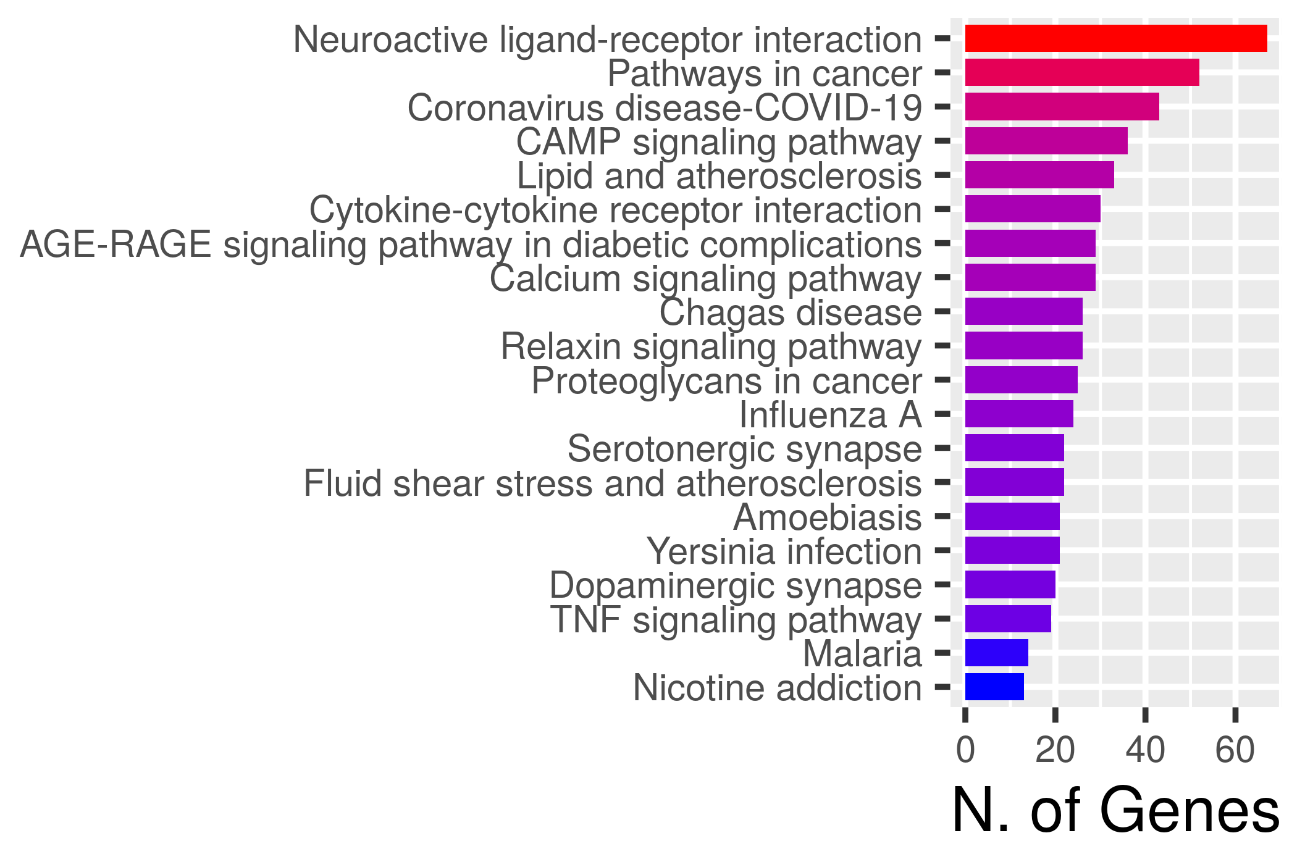
Migraine PPI Network & Major Pathways
Immune-inflammation, 5-HT/DA, Ca-signaling pathways
Disgenet & STRING (v2.0) (www.string-db.org)
481 nodes | 6073 edges | av. Node degree: 25.3
ShinyGO 0.80 (www.bioinformatics.sdstate.edu)

Slide 6
Pharmacodynamics 2.0
‘Omics’ (genomics, protein-protein interactions, etc.) studies reveal that disease typically involves multiple targets and pathways
Targets
Proteins (genes)
Receptors, enzymes, etc.
Disease Targetome
Biological Pathways
Multiple Cellular Functions
Agents
Drugs, compounds
Role of multicomponent therapies

Slide 7
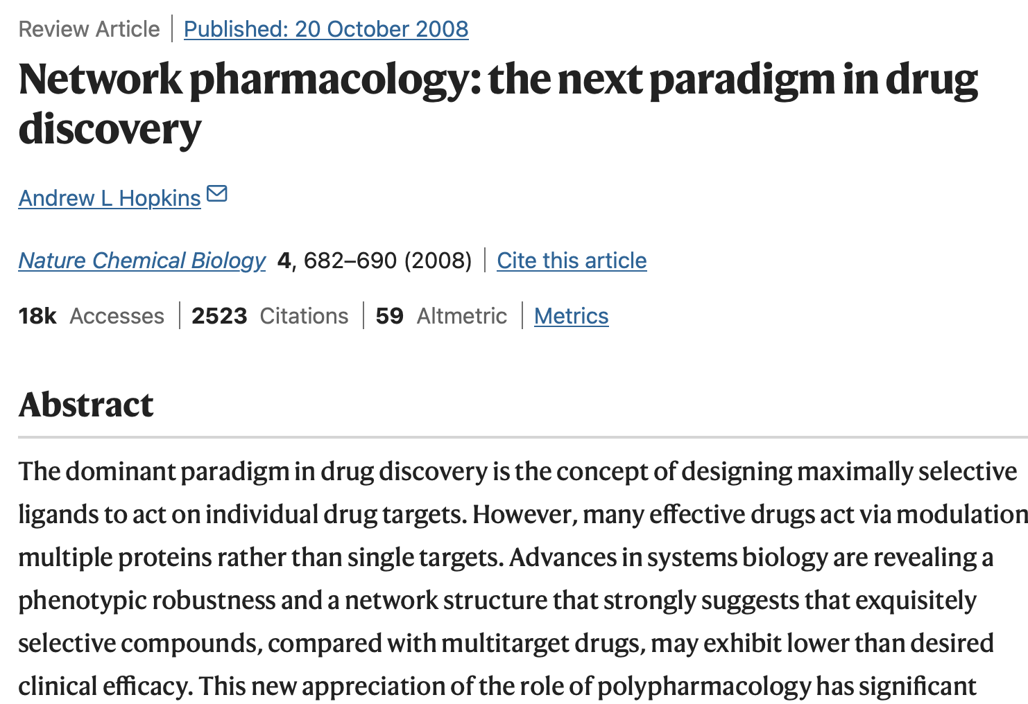
Network Pharmacology
Integrative approach using computational methods
Predicts how multicomponent therapies interact with disease networks
Emphases a “network-target, multicomponent-therapy” paradigm
Uses network topology & centrality measures to identify most important nodes in the ‘targetome’
Betweenness centrality (number of nonredundant shortest paths traveling through a node) appears to be more important than degree centrality
Idea is that you may not want to target hubs (based on degree centrality), but rather non-hub bottlenecks in the network (less lethality)
Hopkins AL. Network pharmacology: the next paradigm in drug discovery. Nat Chem Biol. 2008;4(11):682-690.

Slide 8
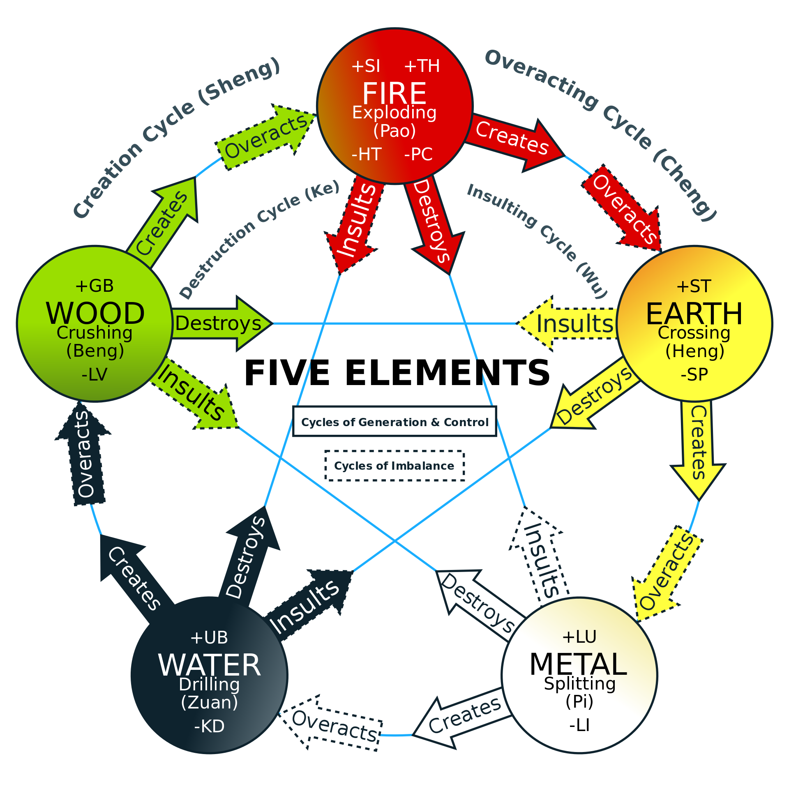
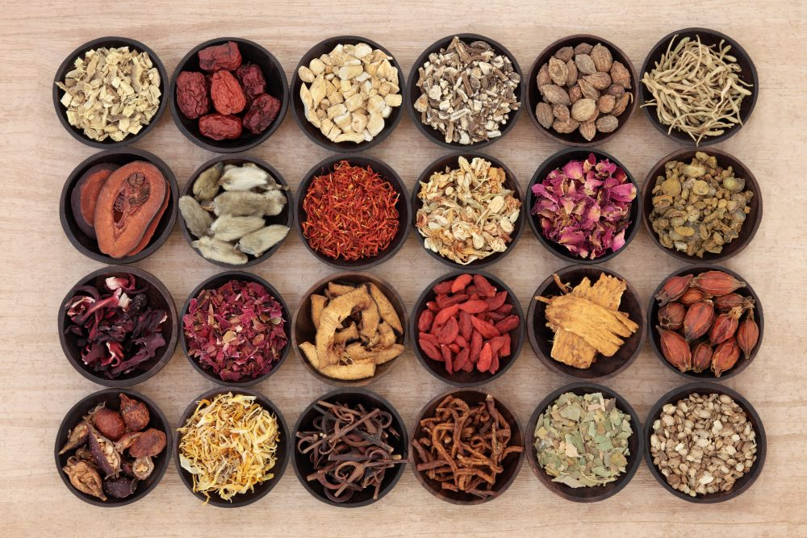
Traditional Chinese Medicine (TCM)
An Ancient Medical System
Modalities: acu-moxa therapy, herbal medicine, qi gong, diet, etc.
Historical records to ~200 BCE
Many different systems and “schools” within Chinese medicine
Practiced alongside biomedical approaches in China
Emphasis on qualitative, systems-based approaches to disease
Pattern-differentiation: organ + organ state
Chinese Herbal Medicine
Complex, multi-component herbal preparations used to treat disease
Increasing number of high quality RCTs show efficacy
Mechanistic understanding of herbal action is often lacking
A single formula may have 10 herbs, with thousands of constituents
Current research: formulas target multiple biological pathways
Bioinformatics and Chinese Herbal Medicine
Databases containing herb-compound-target information now exist
Network pharmacology can now be applied to elucidate herbal formula actions and potentially expand the drug discovery space
Noor F, Tahir Ul Qamar M, Ashfaq UA, Albutti A, Alwashmi ASS, Aljasir MA. Network Pharmacology Approach for Medicinal Plants: Review and Assessment. Pharmaceuticals (Basel). 2022;15(5):572. Published 2022 May 4. doi:10.3390/ph15050572
Notes:
Understanding TCM preparations using network pharmacology-based analysis has been studied in:
Covid: Yu S, Wang J, Shen H. Network pharmacology-based analysis of the role of traditional Chinese herbal medicines in the treatment of COVID-19. Ann Palliat Med. 2020;9(2):437-446. doi:10.21037/apm.2020.03.27
Ischemic Heart Disease: Yang HY, Liu ML, Luo P, Yao XS, Zhou H. Network pharmacology provides a systematic approach to understanding the treatment of ischemic heart diseases with traditional Chinese medicine. Phytomedicine. 2022;104:154268. doi:10.1016/j.phymed.2022.154268
Asthma: Wu Z, Luo Z, Sun W, Shi Y, Ding Q. Integrating Network Pharmacology and Experimental Validation to Elucidate the Mechanism of Jiegeng Decoction in Improving Allergic Asthma. ACS Omega. 2023;8(50):48081-48090. Published 2023 Dec 6. doi:10.1021/acsomega.3c06914
Irritable bowel syndrome: Meng M, Bai C, Wan B, et al. A Network Pharmacology-Based Study on Irritable Bowel Syndrome Prevention and Treatment Utilizing Shenling Baizhu Powder. Biomed Res Int. 2021;2021:4579850. Published 2021 Nov 23. doi:10.1155/2021/4579850
Cancer: Chamberlin SR, Blucher A, Wu G, et al. Natural Product Target Network Reveals Potential for Cancer Combination Therapies. Front Pharmacol. 2019;10:557. Published 2019 May 31. doi:10.3389/fphar.2019.00557

Slide 9
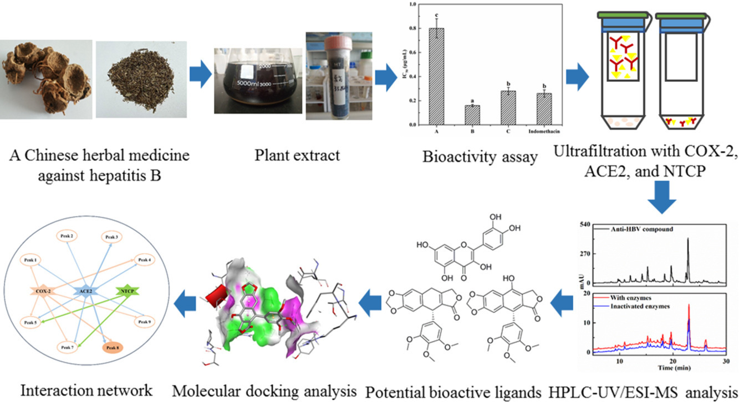
Gathering Constituent Data from TCM Herbs
Huixia Feng, Guilin Chen, Mingquan Guo. Potential multifunctional components explored in Chinese herbal medicine against hepatitis B combining multi-target affinity ultrafiltration HPLC/MS. Phytomedicine Plus, Volume 3, Issue 1, 2023.
Notes:
Example of the process of collecting compound information from Chinese herbs

Slide 10
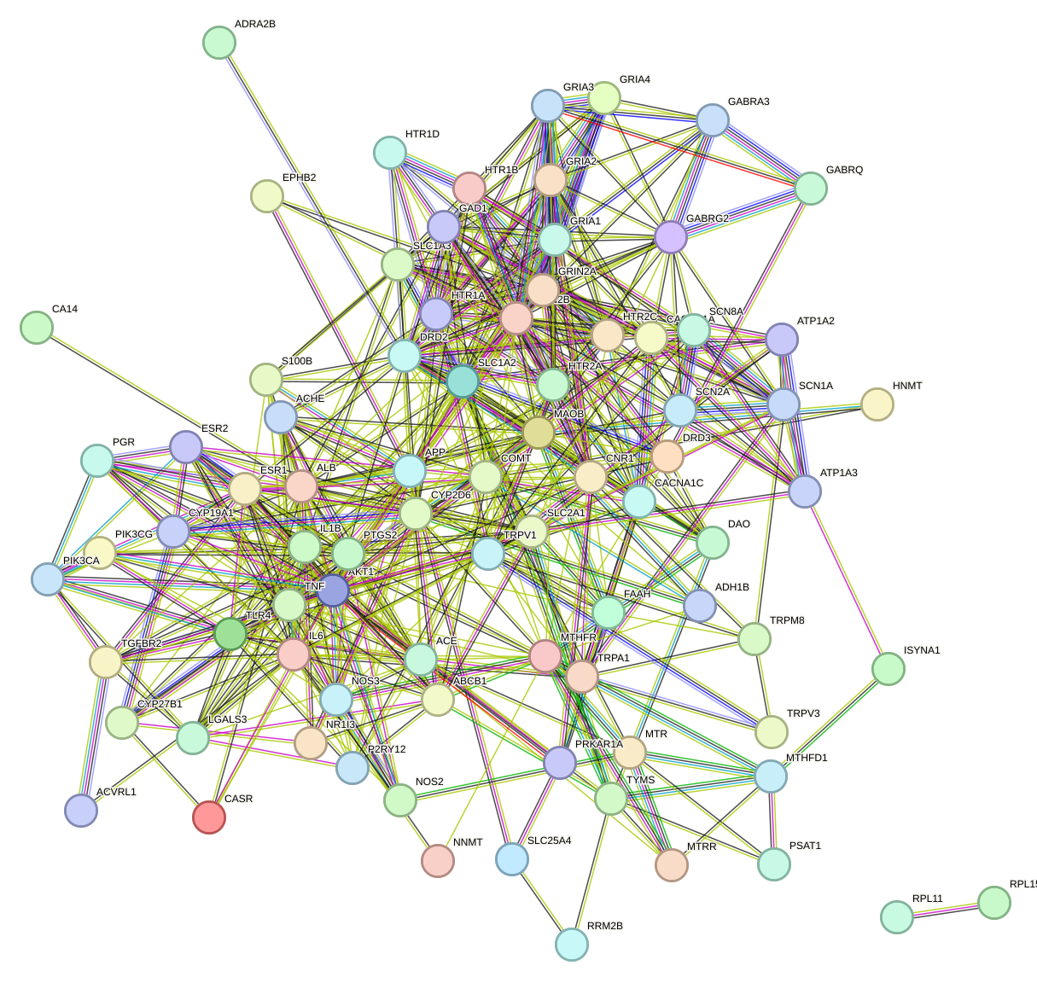
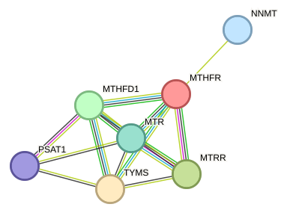
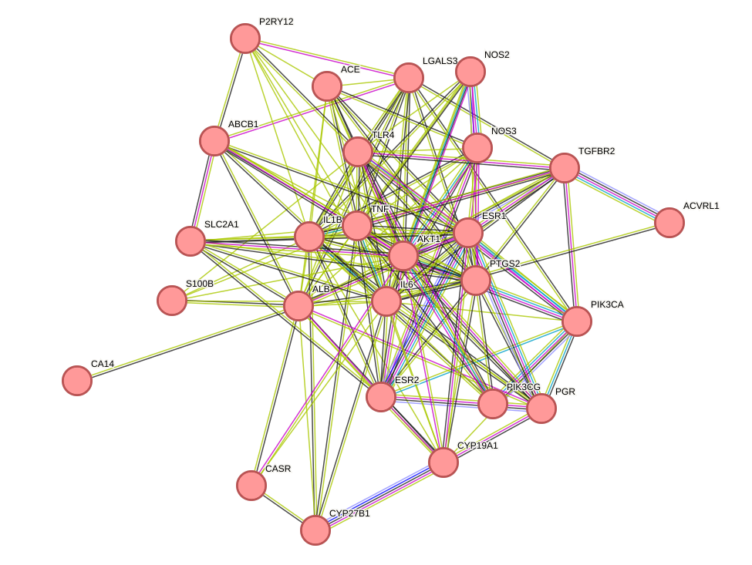
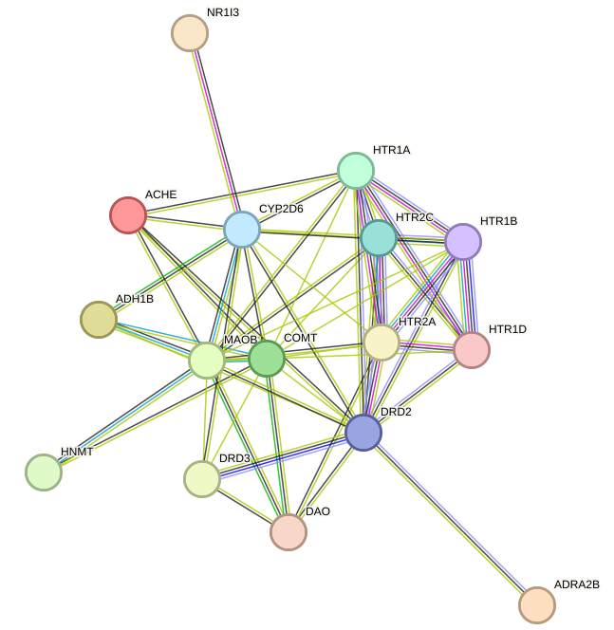
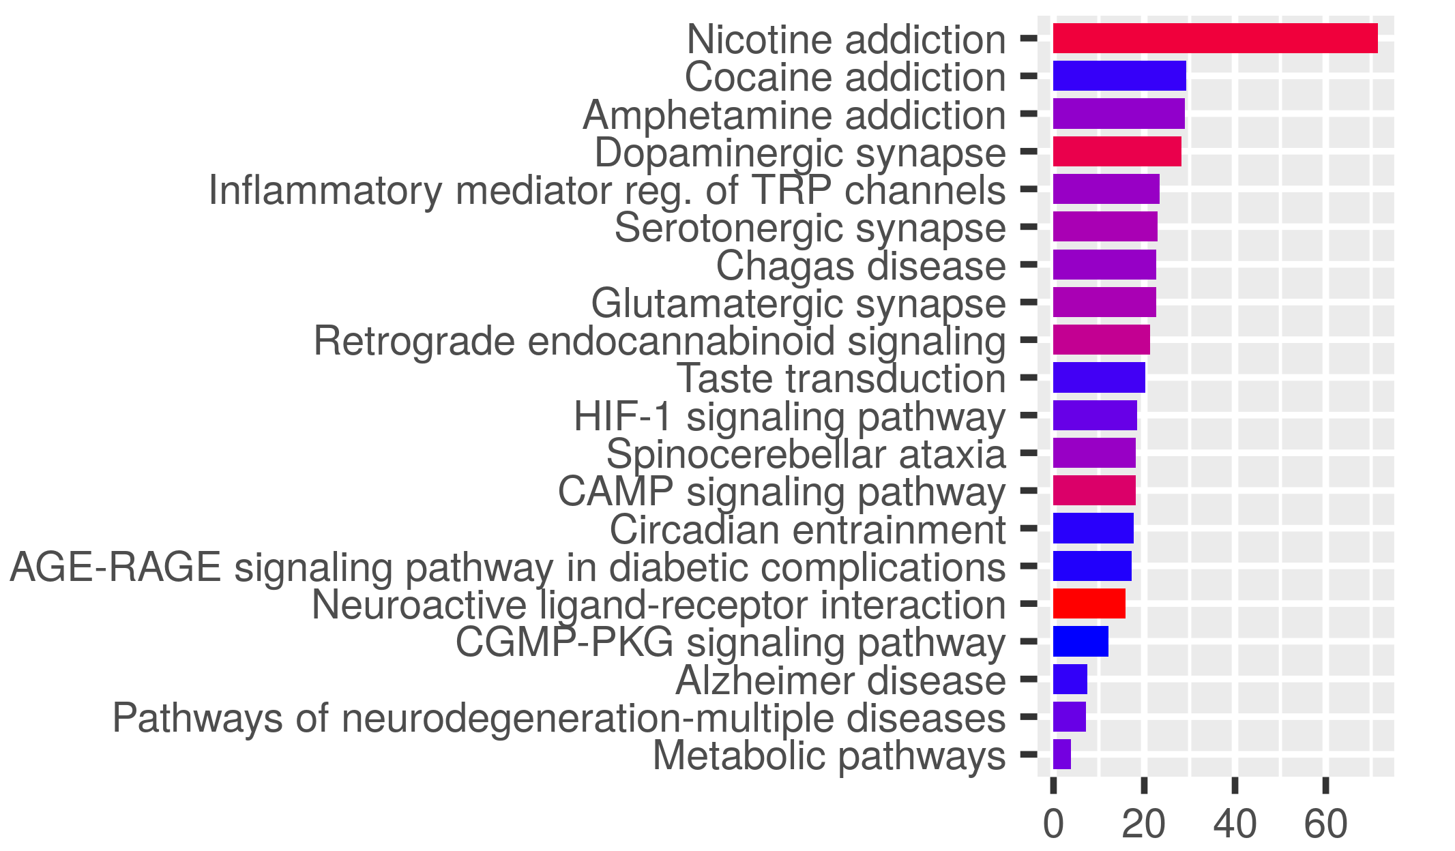
Project: Apply Network Approaches to Help Understand Chinese Herbal Action in Migraine
TCM Herb Targets
Gather migraine herbs based on available studies
Gather constituents & known herb gene-protein targets
Batman2.0
ETCM
PPI Network
Analyze Network
Find Pathways
Find common targets between both lists
Obtain PPI Interaction Network
Graph the network
Python
STRING database
Components
Use largest component
Betweenness Centrality
Pick top 20 based on BC
Clusters
Use clustering algorithm to find major clusters
Networkx
Gene ontologies
KEGG pathways
Reactome
ShinyGO 0.80
Reactome
Migraine Targets
Gather migraine gene-protein targets
Disgenet
Conclusions

Slide 11
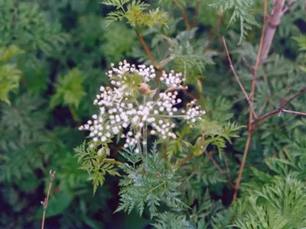

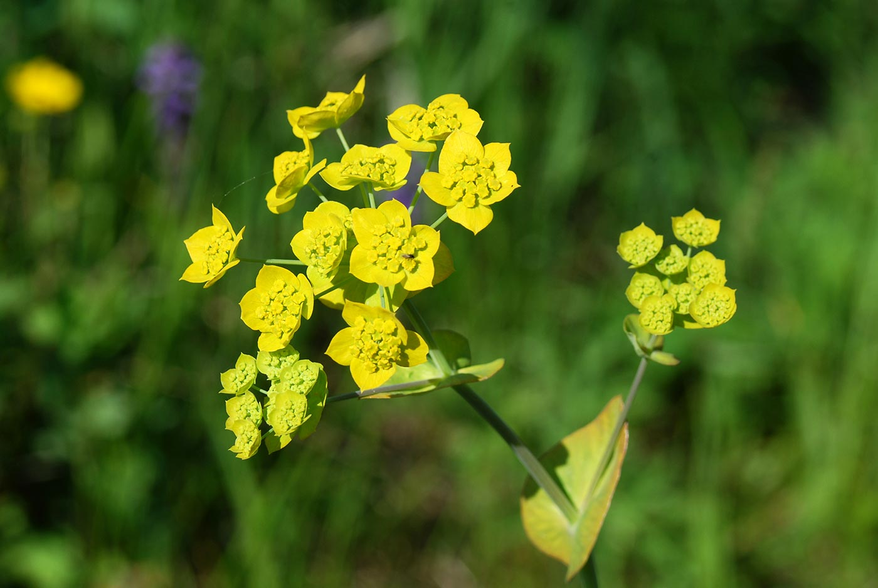
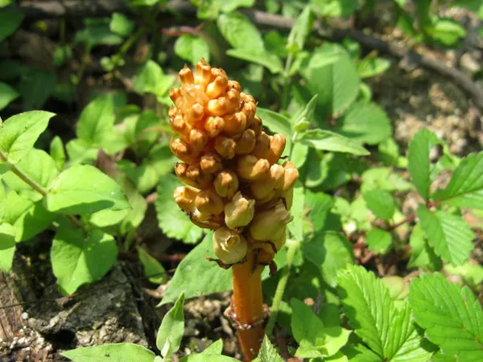
Find TCM Herb Targets Commonly Used TCM Herbs in Migraine¹
Herb (Pin yin) | Genus/Species | Studies
Chuan xiong | Ligusticum striatum (rhizome) | 31
Bai zhi | Angelica dahaurica (root) | 18
Bai shao | Peonia lactiflora (root) | 16
Dang gui | Angelica sinensis (root) | 12
Chai hu | Bupleurum chinense (root) | 11
Tian ma | Gastrodia elata (rhizome) | 13
Gou teng | Uncaria rhynachophylla (rhizome) | 8
Xi xin | Asarum sieboldii (herb) | 9
Jing jie | Schizonepeta tenuifolia (herb) | ?
Compounds
Using full herb list
Batman2.0 Database
Adjusted p-value: 0.05
Druggable score: 0.9
Unique constituents: 2332 (!)
Gene targets: 6587 (!)
ETCM
Encyclopedia of Traditional Chinese Medicine
Can’t adjust druggable scores, etc.
Unique constituents: 506
Gene targets: 751
Other databases mentioned in literature
No longer are active
Can’t be loaded
1) Lyu S, Zhang CS, Guo X, Zhang AL, Sun J, Lu C, Xue CC, Luo X. Oral Chinese Herbal Medicine as Prophylactic Treatment for Episodic Migraine in Adults: A Systematic Review and Meta-Analysis of Randomized Controlled Trials. Evid Based Complement Alternat Med. 2020 Dec 28;2020:5181587
Notes:
Study by Lyu et. al. (2020):
Systematic review and meta-analysis of herbs used as prophylactic treatment for migraine
35 RCTs, 2840 participants met inclusion criteria; 31 used in meta-analysis
Meta-analysis: Chinese herbal medicine was comparable or superior to flunarizine (a calcium-channel blocker) for migraine prophylaxis
Quality of evidence: low or very low
Identified top ten commonly used herbs in formulas
I decided to use 8 + 1 extra in my study (listed in the slide)
Databases Used:
Batman (2.0): http://bionet.ncpsb.org.cn/batman-tcm/#/home
Encyclopedia of Traditional Chinese Medicine (ETCM): http://www.tcmip.cn/ETCM/

Slide 12
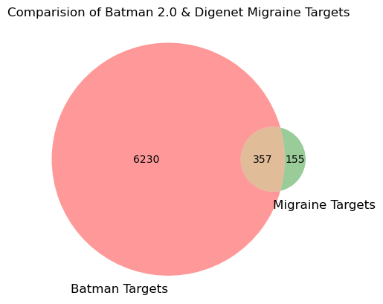
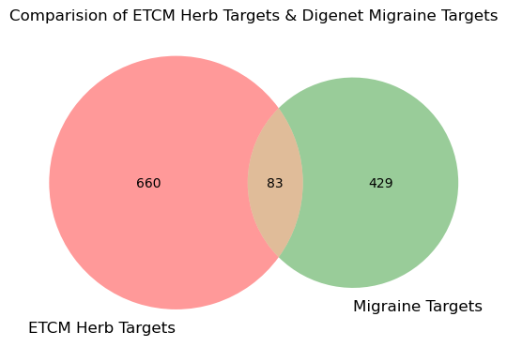
TCM Herb & Migraine Target Overlap Using Disgenet database to obtain migraine targets (‘Common migraine’)
512 migraine-associated genes
Used gene list for further analysis
Overlap Targets (OT)
Notes:
Disgenet.org: https://www.disgenet.org/browser/0/1/0/C0338480/
Search term: ‘Common migraine’
Venn diagrams shown above were drawn using the Python package venn2, found in the matplotlib venn package (version 0.11.10)

Slide 13
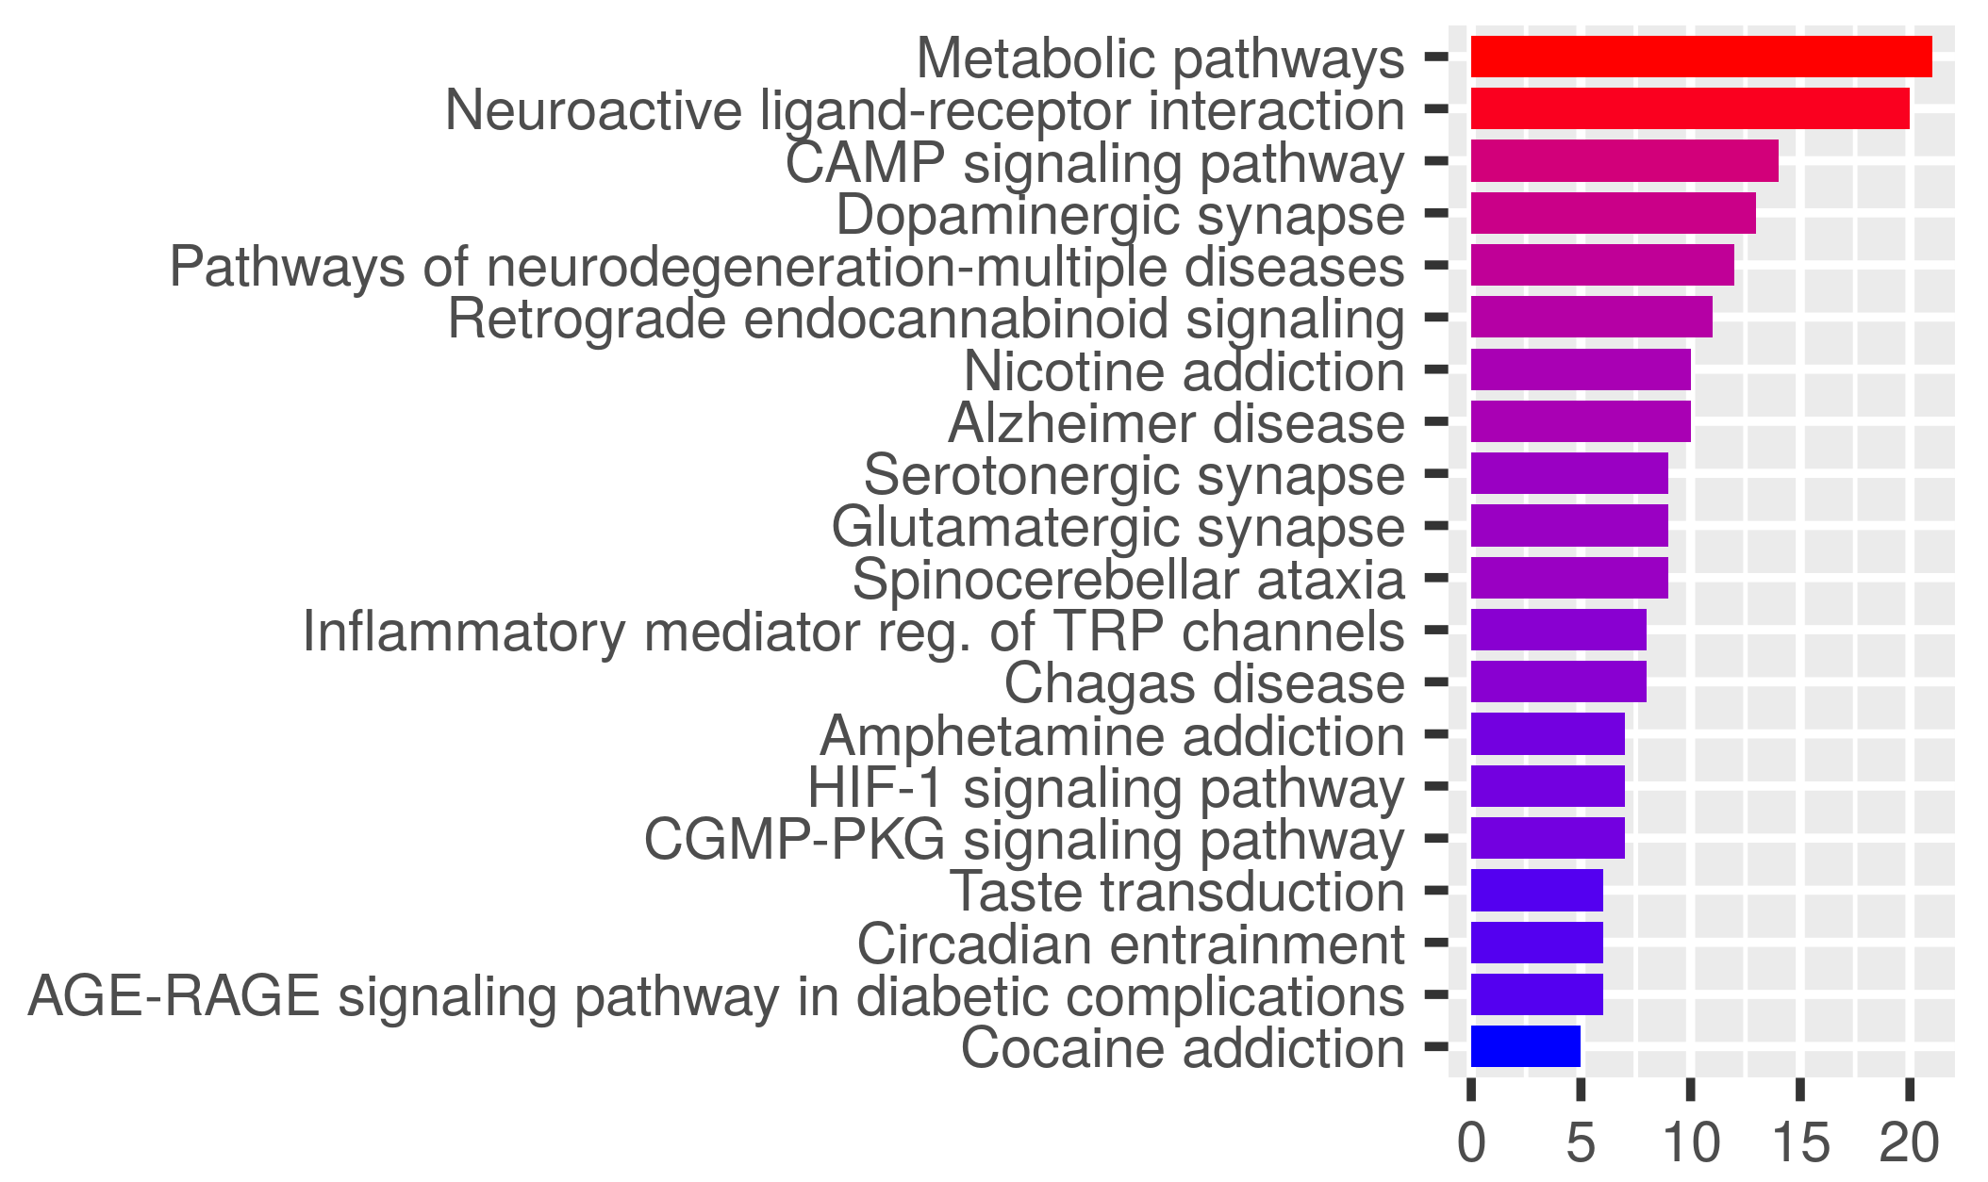
Overlap Targets (OT)-PPI Network
Nodes: 82
Edges: 543
Components: 2
Avg. node degree: 13.2
Avg. local clustering coefficient: 0.579
Major KEGG Pathways
Number of Genes
ShinyGO 0.80
http://bioinformatics.sdstate.edu/go/
STRING
https://string-db.org

Slide 14
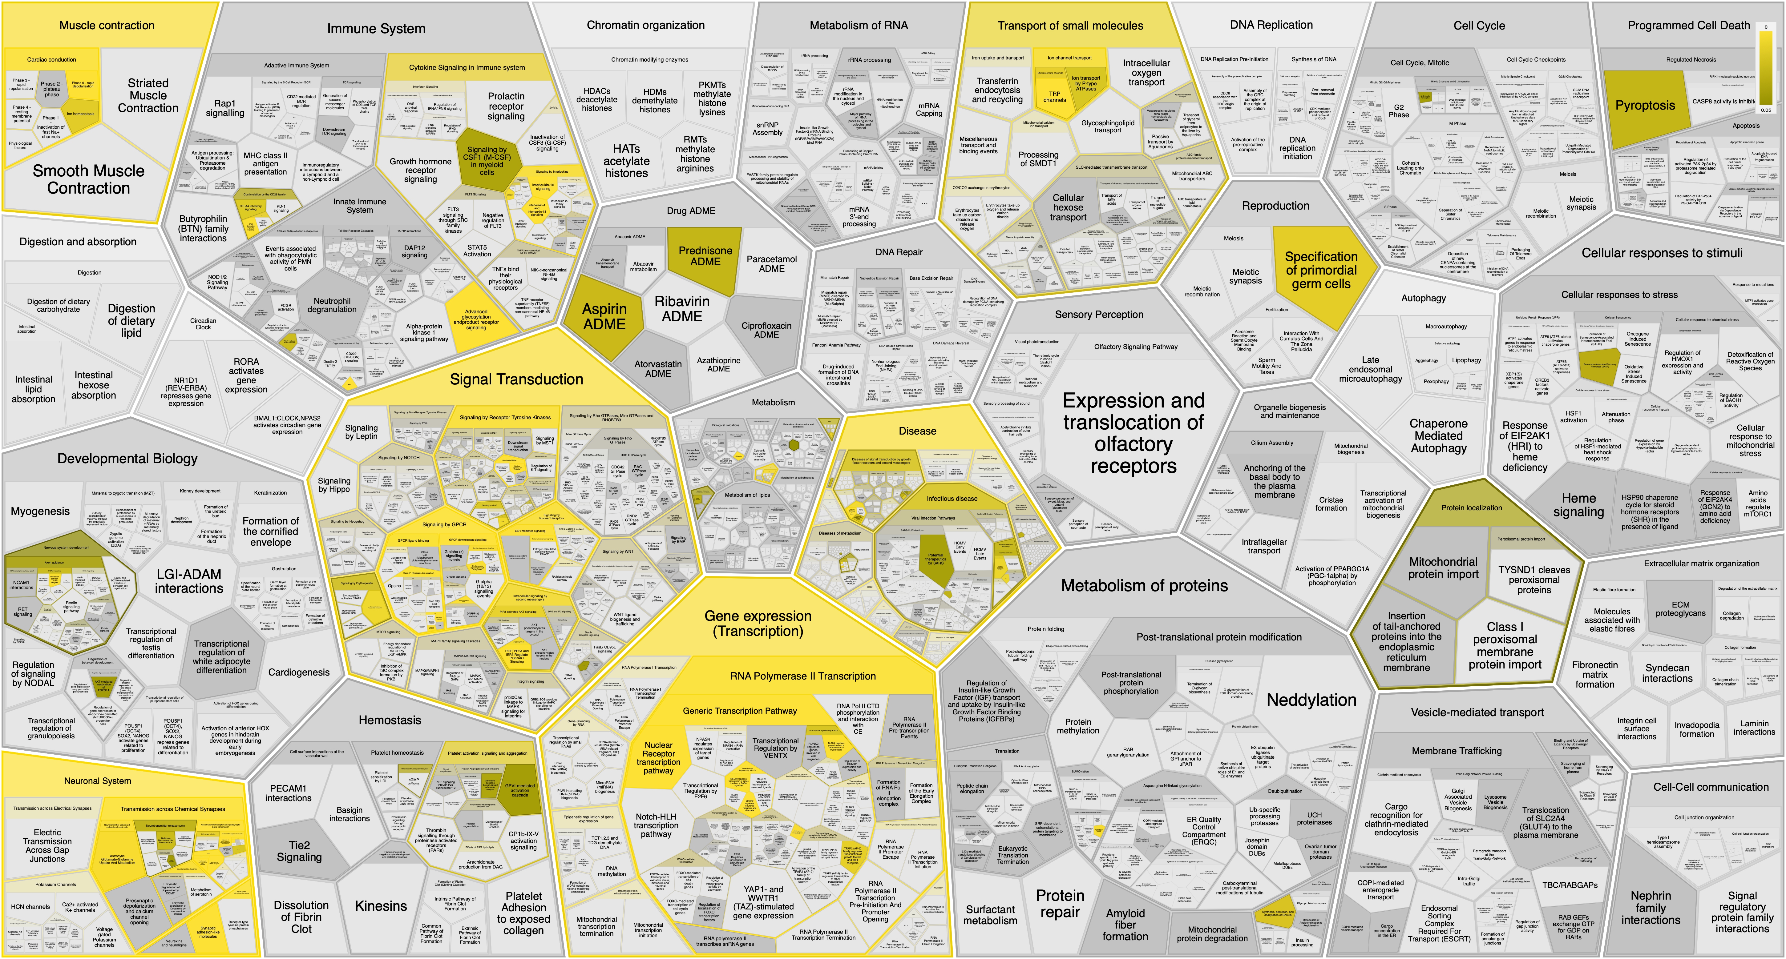
OT Reacfoam (https://reactome.org/)
Notes:
Reactome: https://reactome.org/
Used the Overlap Targets (OT) gene list to create the Reacfoam

Slide 15
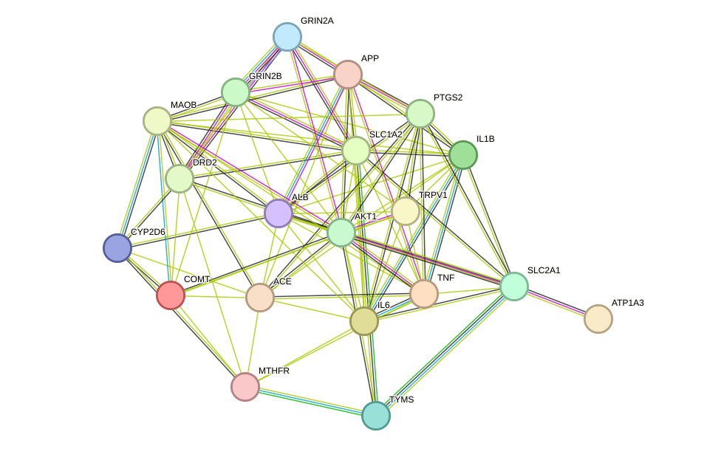
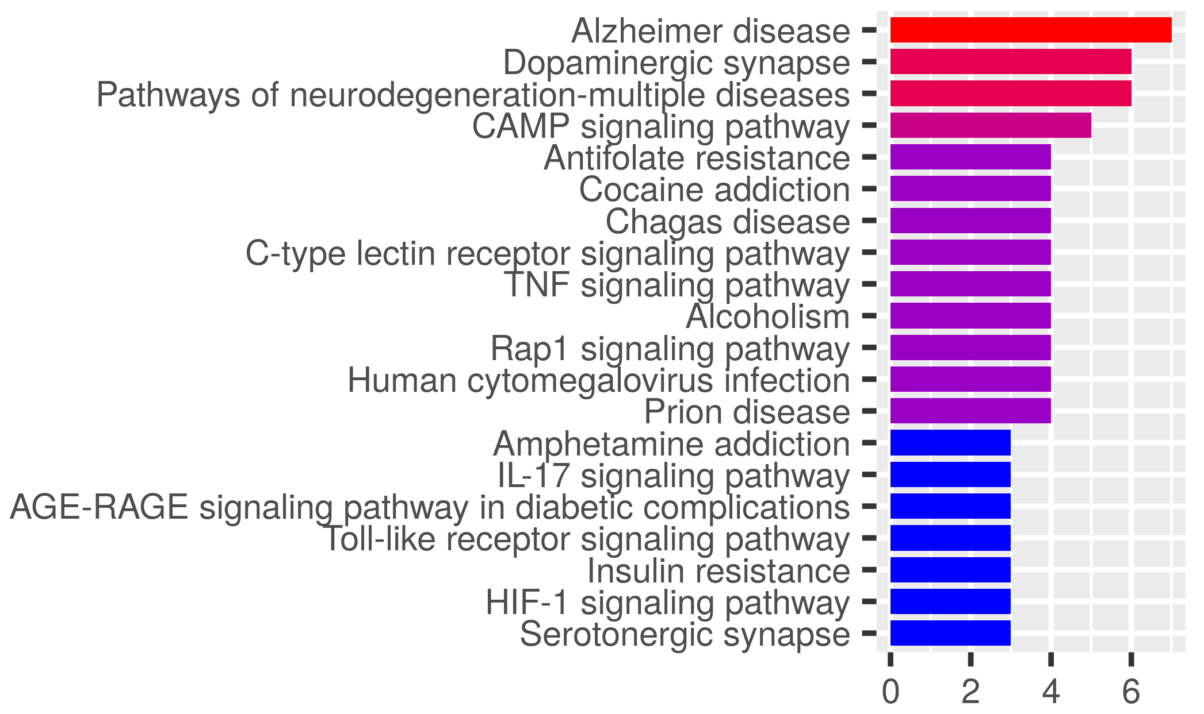
OT-PPI Betweenness Centrality
Nodes: 20 (Used top 20 genes)
Edges: 95
Avg. node degree: 9.5
Avg. local clustering coefficient: 0.662
Top 20 Genes
AKT1
ALB
IL6
APP
COMT
GRIN2B
DRD2
MTHFR
TYMS
MAOB
TRPV1
SLC1A2
SLC2A1
TNF
GRIN2A
IL1B
PTGS2
ACE
ATP1A3
CYP2D6
Major KEGG Pathways
DA, 5HT, inflammation pathways
Number of Genes
STRING
https://string-db.org
ShinyGO 0.80
http://bioinformatics.sdstate.edu/go/
Notes:
Betweenness centrality calculated using Python (version 3.12.2) package `NetworkX` (version 3.1)
Top 20 genes were chosen
Prominent genes in network:
AKT1: involved in inflammation and cancer signaling; mTOR and insulin pathways
ALB: albumin, blood protein
IL6: interleukin 6, pro-inflammatory cytokine
APP: amyloid precursor protein
COMT: methylation of biogenic amines (neurotransmitters)

Slide 16
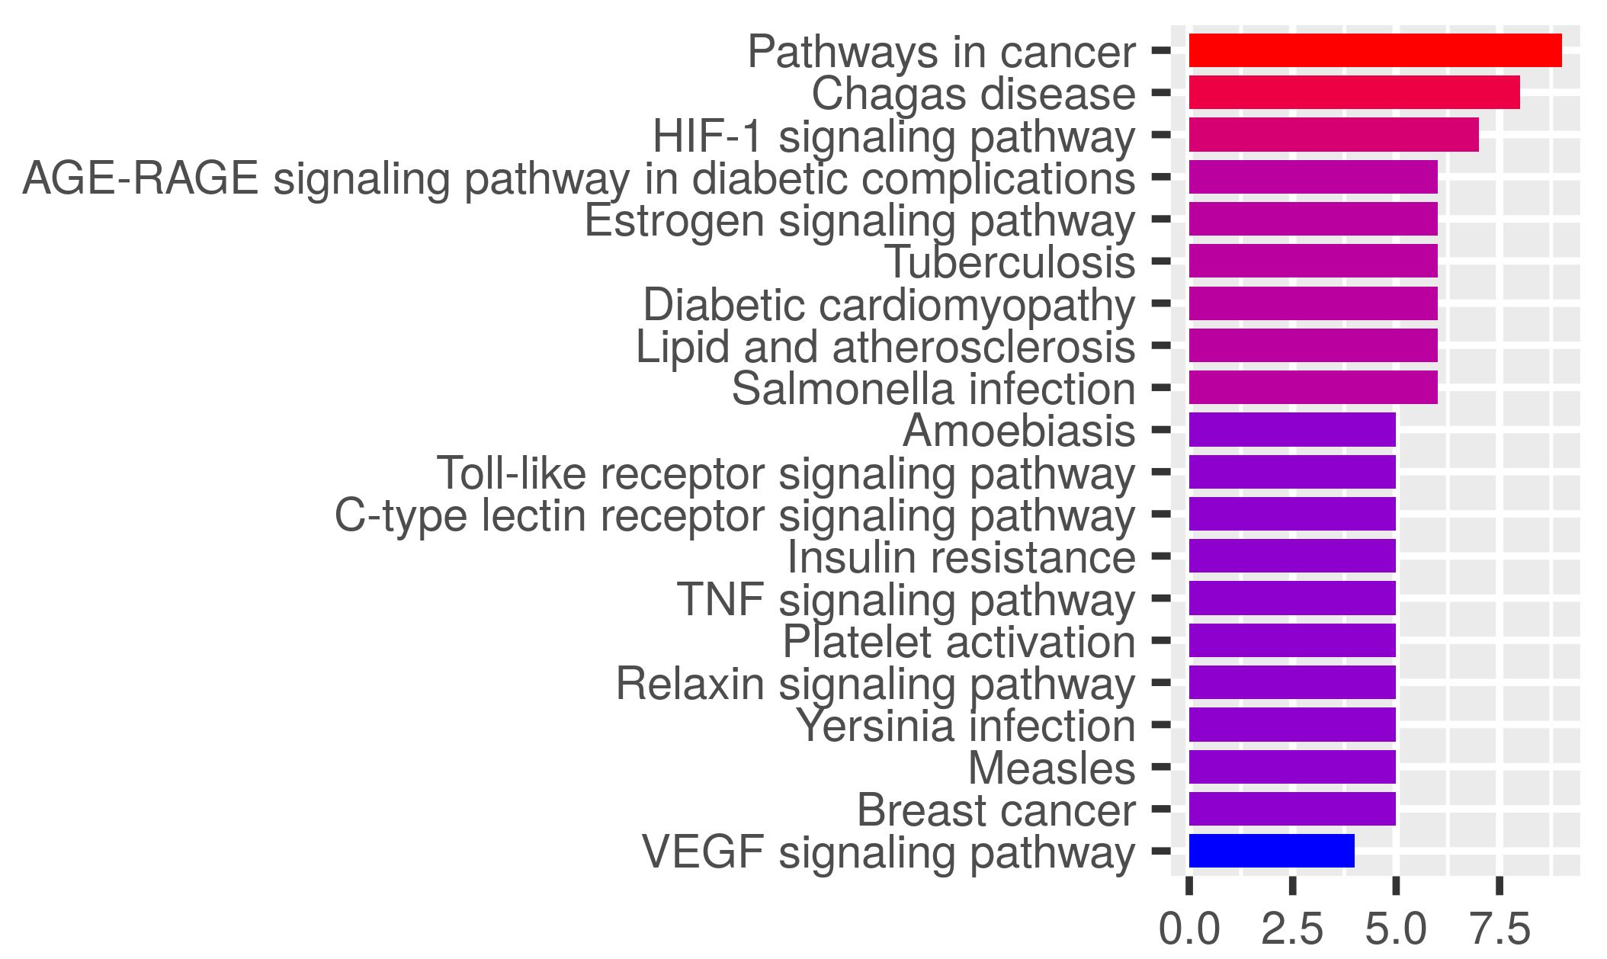
OT-PPI Cluster Analysis: Cluster 1
MCL (Markov) Clustering: Detected 10 Clusters
Major KEGG Pathways
Number of Genes
Inflammation, Vascular, Estrogen Signaling
26 nodes | 153 edges
STRING https://string-db.org
ShinyGO 0.80
http://bioinformatics.sdstate.edu/go/
Notes:
Predominant genes in network:
AKT1: codes for protein-kinase A, involved in insulin, mTOR signaling; cancers
IL6: interleukin 6; pro-inflammatory cytokine
TNF: tumor necrosis factor; pro-inflammatory cytokine

Slide 17
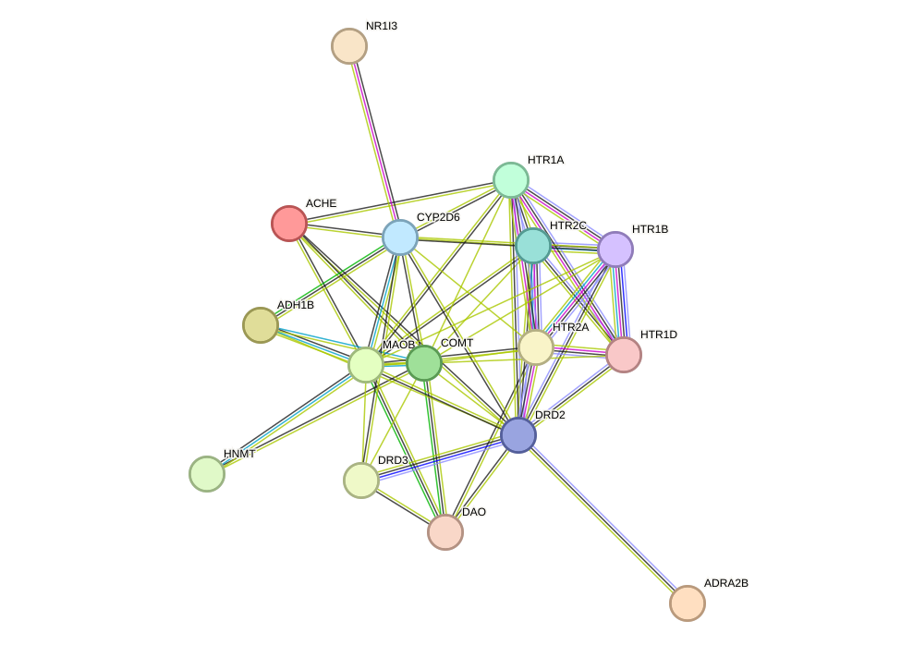
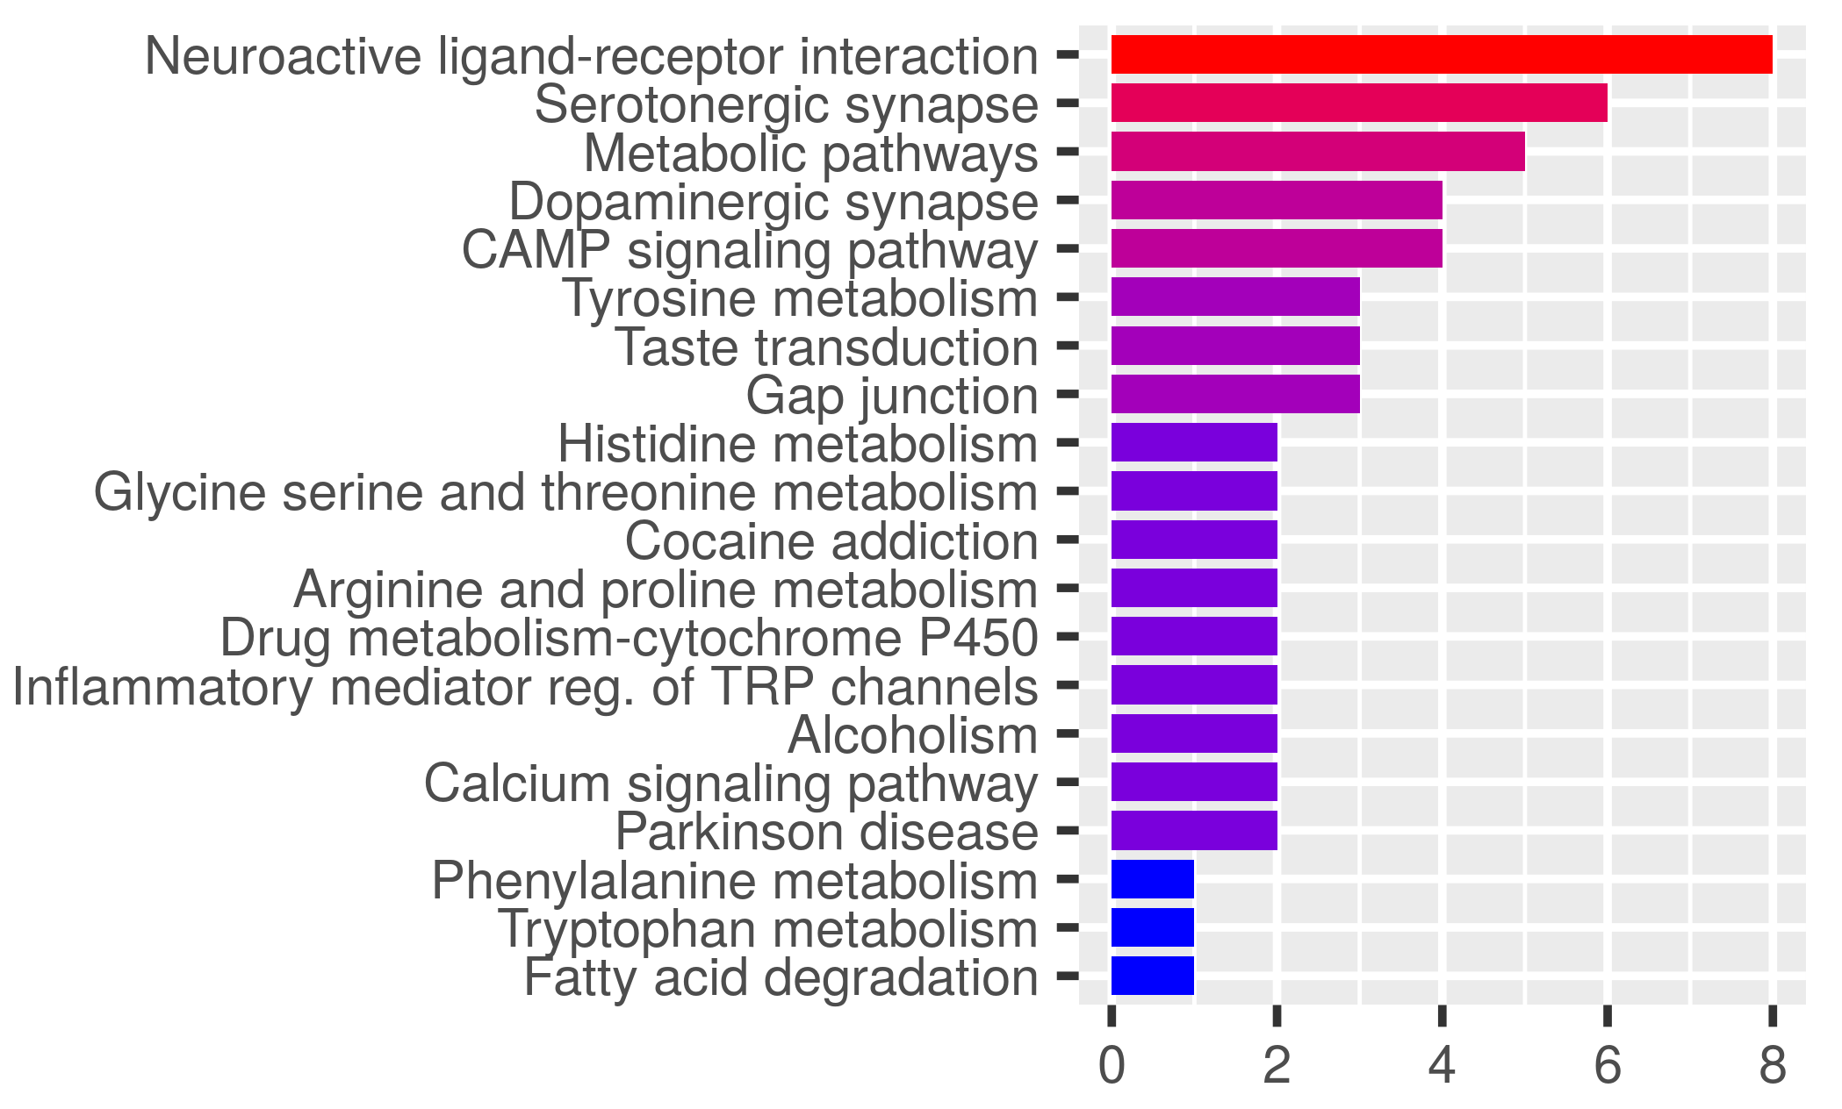
OT-PPI Cluster 2
Based on MCL (Markov) Clustering
Major KEGG Pathways
Number of Genes
5HT, DA Signaling
16 nodes | 56 edges
STRING https://string-db.org
ShinyGO 0.80
http://bioinformatics.sdstate.edu/go/
Notes:
Predominant genes in network:
HTR2A: involved in post-synaptic serotonin signaling
HTR2C: involved in serotonin signaling
HTR1B: G-protein receptor for sertonin

Slide 18
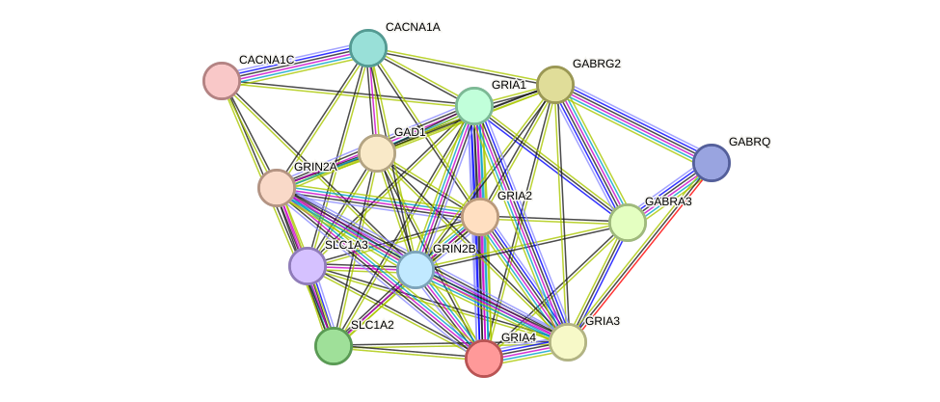
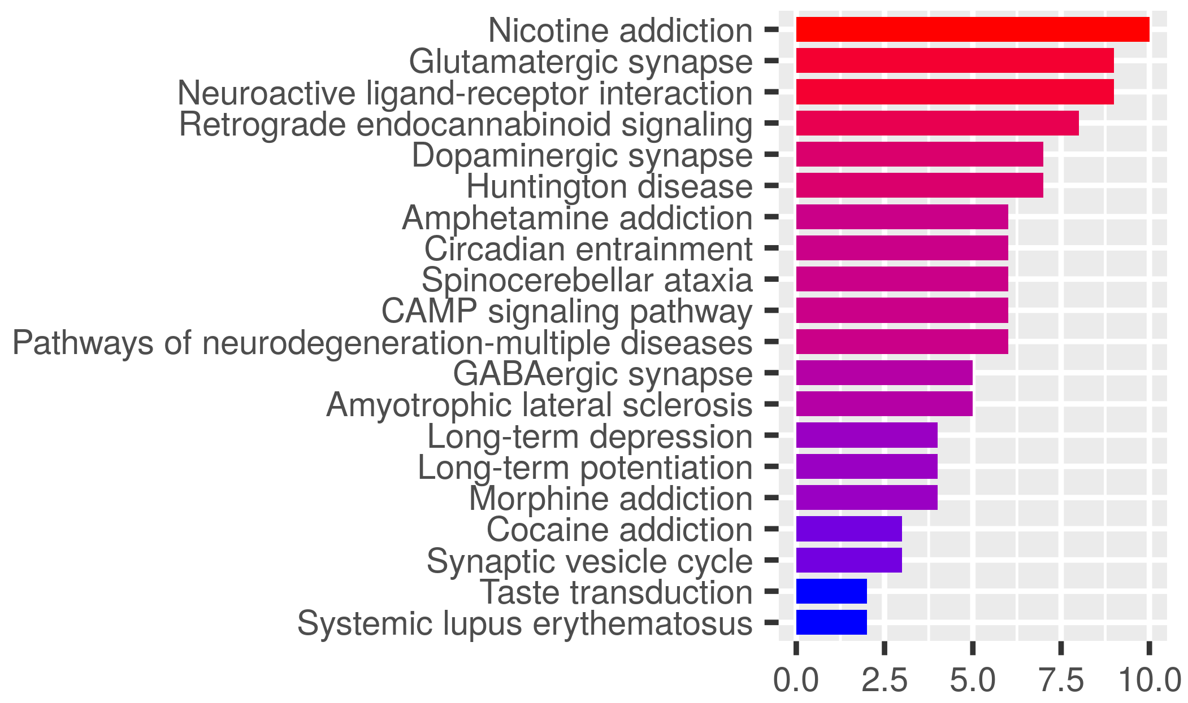
OT-PPI Cluster 3
Based on MCL (Markov) Clustering
Major KEGG Pathways
Number of Genes
GABA, Glu, DA Pathways
14 nodes | 64 edges
STRING https://string-db.org
ShinyGO 0.80
http://bioinformatics.sdstate.edu/go/
Notes:
Prominent genes in the network – they all code for glutamate receptors
GRIA1
GR1A2
GR1A4

Slide 19
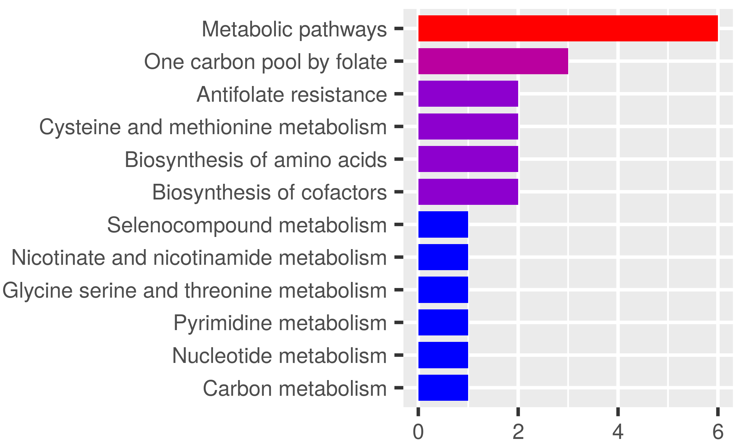
OT-PPI Cluster 4
Based on MCL (Markov) Clustering
Major KEGG Pathways
Number of Genes
Amino acid, nucleotide, methylation pathways
7 nodes | 14 edges
STRING https://string-db.org
ShinyGO 0.80
http://bioinformatics.sdstate.edu/go/
Notes:
Prominent nodes in the network – these are all methylation genes
MTHFR
MTR
TYMS

Slide 20
Conclusions
Summary
The 9 most used Chinese herbs for migraine prophylaxis were obtained through a literature review
Targets for these herbs were obtained using the ‘Encyclopedia of Traditional Chinese Medicine (ETCM)’ database
Migraine targets were obtained using the Digenet.org database
The intersection between these lists were compiled into a PPI network using the STRING database
The resulting PPI network was subject to network analysis (betweenness centrality, cluster analysis)
The top 20 KEGG pathways were obtained for each method
Findings
A ‘Chinese Herbal Network Pharmacology’ method can reveal mechanistic insights into biological pathways activated
Analysis of an herb-disease-target network reveals that commonly used Chinese herbs target inflammatory, neurotransmitter (serotonin, dopamine, GABA, glutamate), endothelial, and estrogen signaling pathways
Further understanding these pathways could inspire novel research into the effects of Chinese herbal medicines
Limitations
Quality of constituent-target information in known databases is suspect
Lack of oral bioavailability and specific target binding information (up-regulates or inhibits target?)
Need further research to determine if betweenness centrality and Markov clustering are most useful measures
Notes:
This project has inspired me to think more about how to create a comprehensive herb-compound-target database based on HPLC and “fingerprint” compounds

